Slide 1
Setting up a MySQL connection

Slide 2


Slide 3


Slide 4
ORM

Slide 5


Slide 6
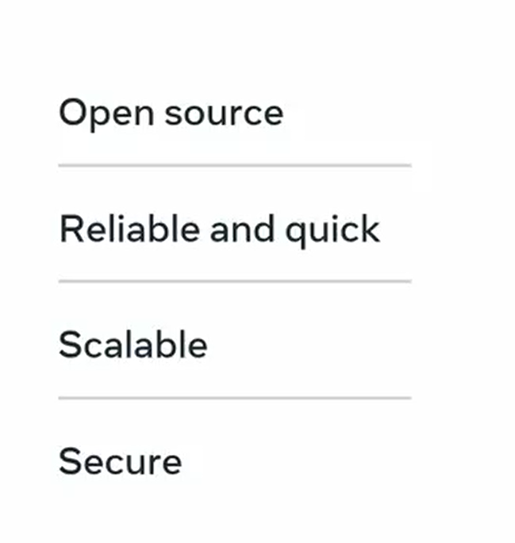

Slide 7
